Slide 1
FUNCTIONAL APPROACH TO WRITE CODE
Kyrylo Abramov

Slide 2

FUNCTIONAL APPROACH TO WRITE CODE
What is functional programming
What functional programming isn’t ;-)
Common patterns

Slide 3

PARADIGMS
JavaScript is a multi-paradigm language and can be written following different programming paradigms. A programming paradigm is essentially a bunch of rules that you follow when writing code.
JavaScript allows you to freely mix and match object-oriented, procedural, and functional paradigms.

Slide 4
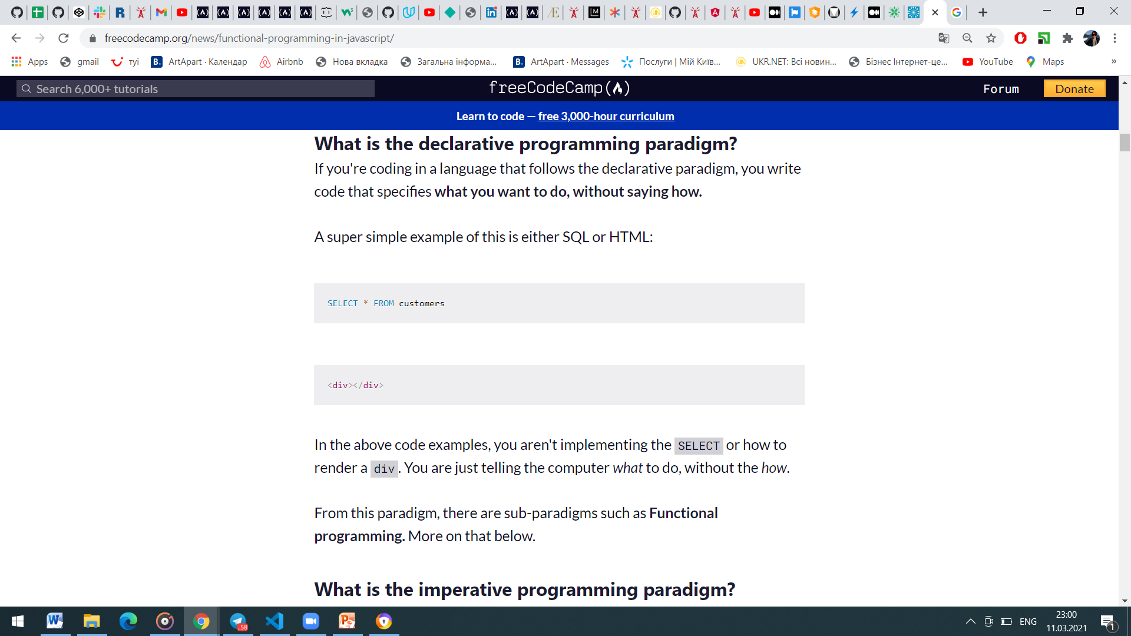
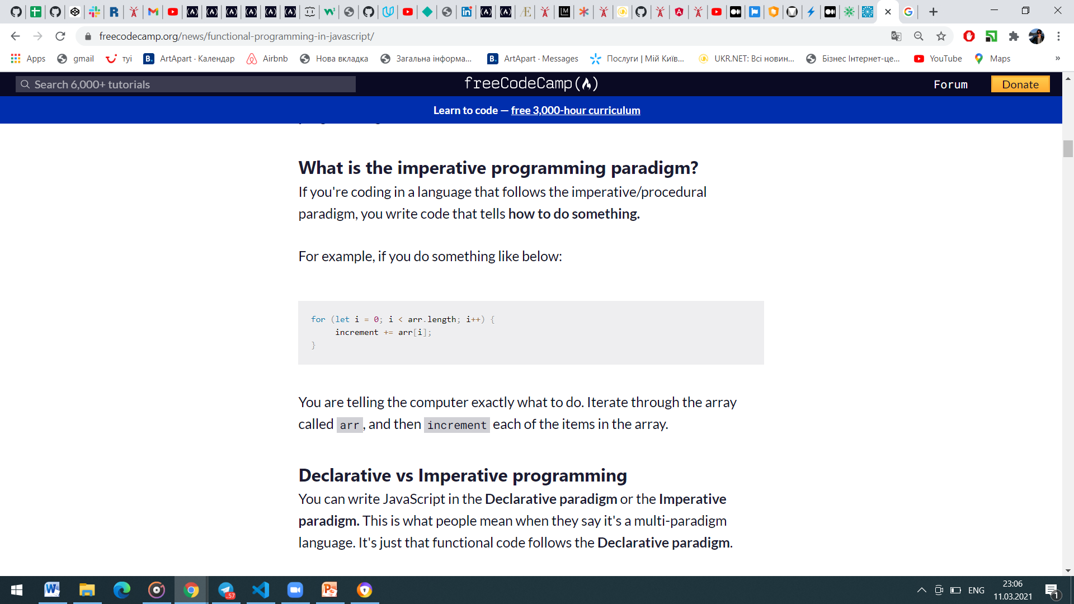
WHAT IS FUNCTIONAL PROGRAMMING?
Functional programming is a sub-paradigm of the Declarative programming paradigm, with its own rules to follow when writing code.
What is the declarative programming paradigm?
If you're coding in a language that follows the declarative paradigm, you write code that specifies what you want to do, without saying how.
What is the imperative programming paradigm?
If you're coding in a language that follows the imperative/procedural paradigm, you write code that tells how to do something.

Slide 5
FUNCTIONAL PROGRAMMING RULES
You architect your software out of pure, isolated functions
Pure functions
The same input always gives the same output (idempotence), and has no side effects.
2. You avoid mutability and side-effects
Isolated functions
There is no dependence on the state of the program, which includes global variables that are subject to change.

Slide 6
WHAT IS NOT FUNCTIONAL PROGRAMMING?
Loops
while
do...while
for
for...of
for...in
Array mutator methods
copyWithin
fill
pop
Push
reverse
shift
sort
Variable declarations with var or let
Void functions
Object mutation (for example: o.x = 5;)
Map mutator methods
clear
delete
Set
Set mutator methods
add
clear
delete
splice
unshift

Slide 7
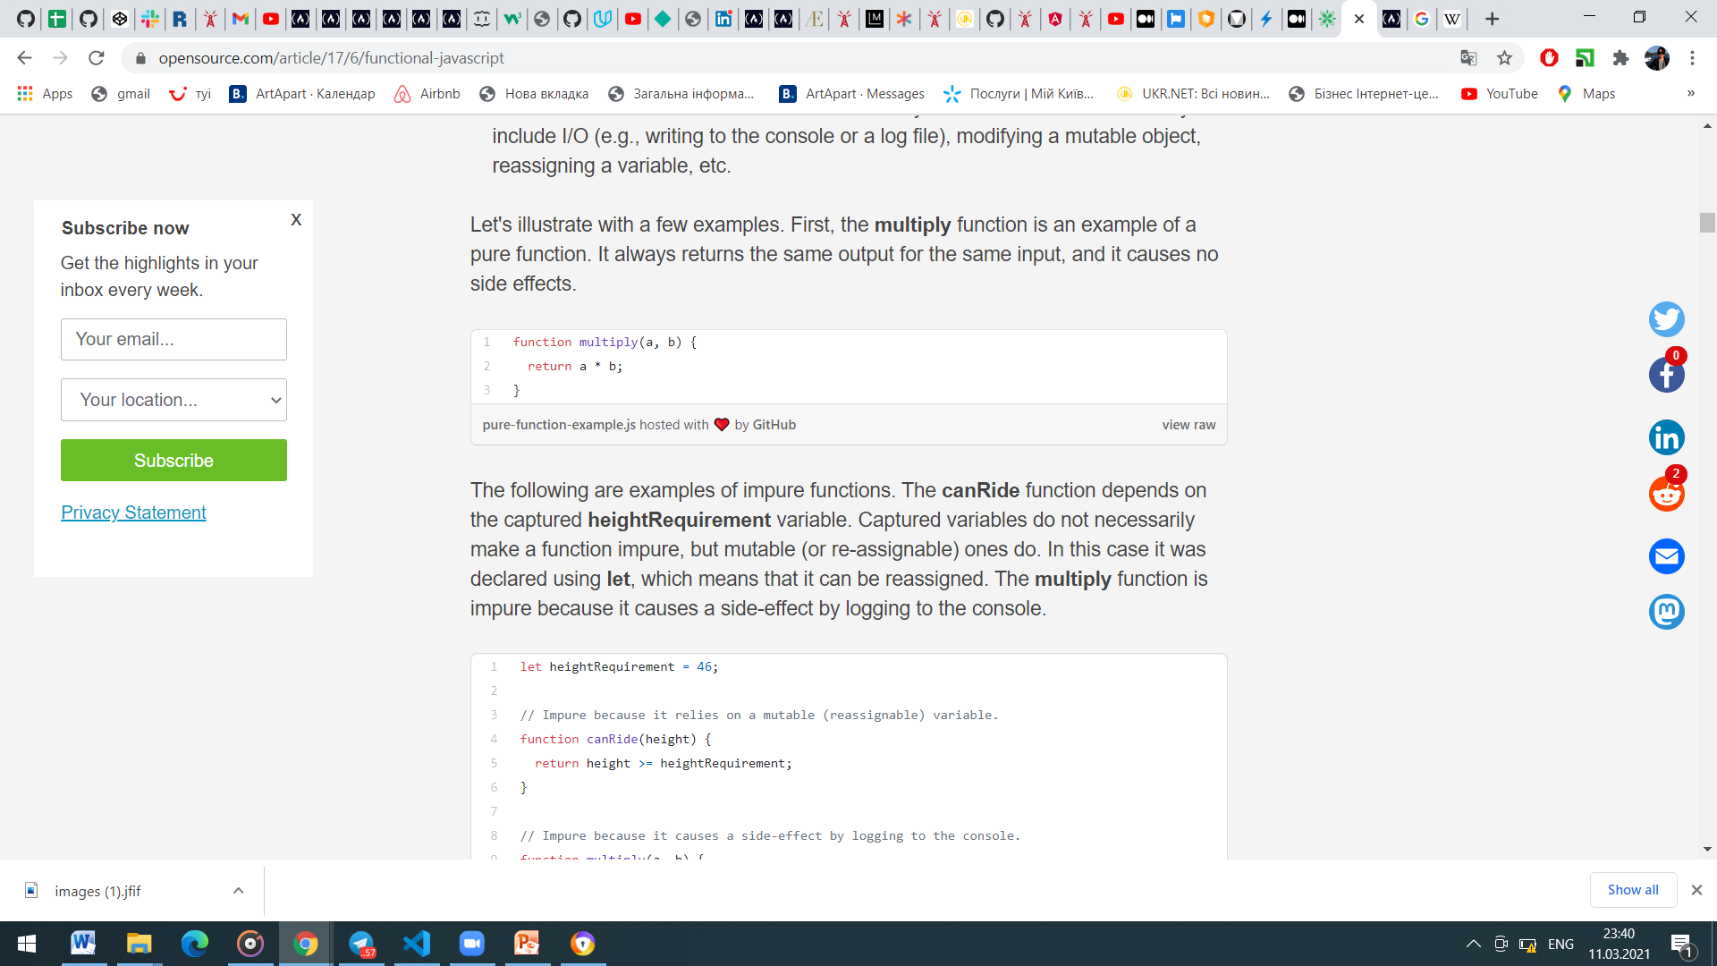
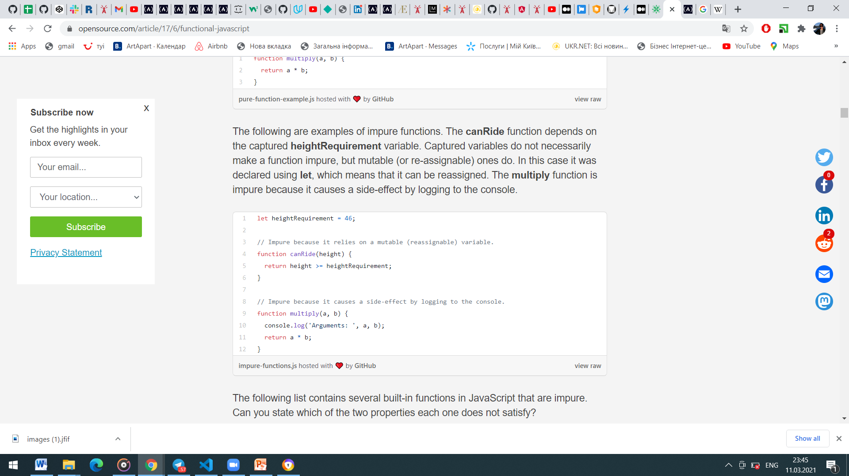
MORE FUNCTIONS
Impure built-in JS functions examples:
console.log
element.addEventListener
Math.random
Date.now
$.ajax (where $ == the Ajax library of your choice)
A good rule of thumb is to follow the 80/20 rule: 80% of your functions should be pure, and the remaining 20%, of necessity, will be impure.

Slide 8
PURE FUNCTIONS BENEFITS:
They're easier to reason about and debug because they don't depend on mutable state.
The return value can be cached or "memorized" to avoid recomputing it in the future.
They're easier to test because there are no dependencies (such as logging, Ajax, database, etc.) that need to be mocked.
If a function you're writing or using is void (i.e., it has no return value), that's a clue that it's impure. If the function has no return value, then either it's a no-op or it's causing some side effect. Along the same lines, if you call a function but do not use its return value, again, you're probably relying on it to do some side effect, and it is an impure function.

Slide 9
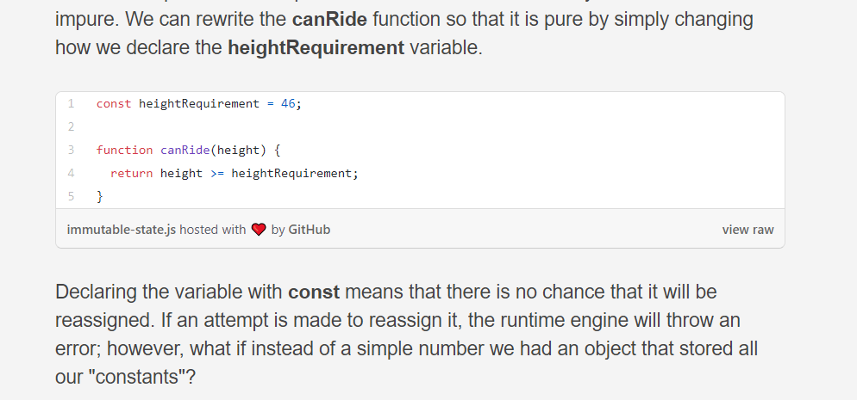
IMMUTABILITY
Immutability pertains to all data structures, which includes arrays, maps, and sets. That means that we cannot call mutator methods such as array.prototype.push because that modifies the existing array. Instead of pushing an item onto the existing array, we can create a new array with all the same items as the original array, plus the one additional item. In fact, every mutator method can be replaced by a function that returns a new array with the desired changes.

Slide 10
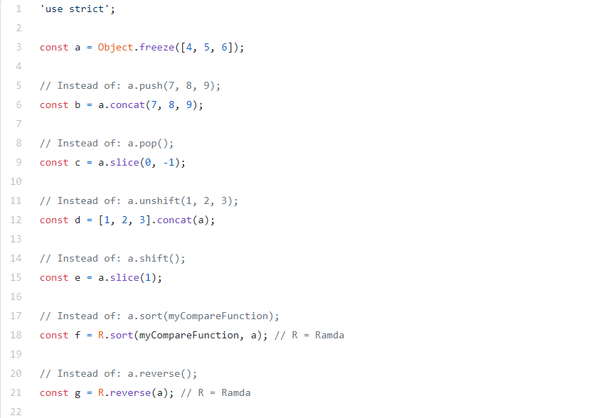
IMMUTABILITY EXAMPLES:

Slide 11
FUNCTIONAL PROGRAMMING APPROACH
Function composition
Recursion
Higher-order functions
Currying

Slide 12
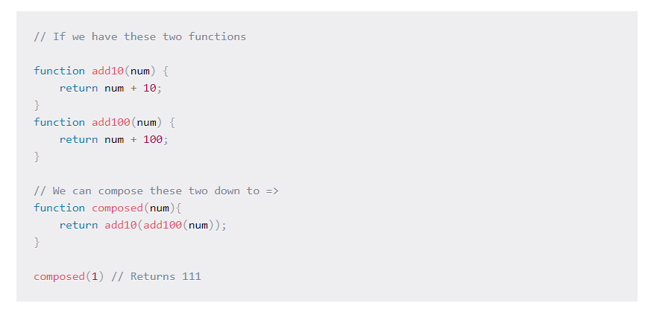
FUNCTION COMPOSITION
Function composition allows us to take two or more functions and turn them into one function that does exactly what the two functions (or more) do.
Why use function composition?
Composition allows you to structure your code out of re-usable functions, to stop repeating yourself. You can start to treat functions like small building blocks you can combine together to achieve a more complicated output.

Slide 13
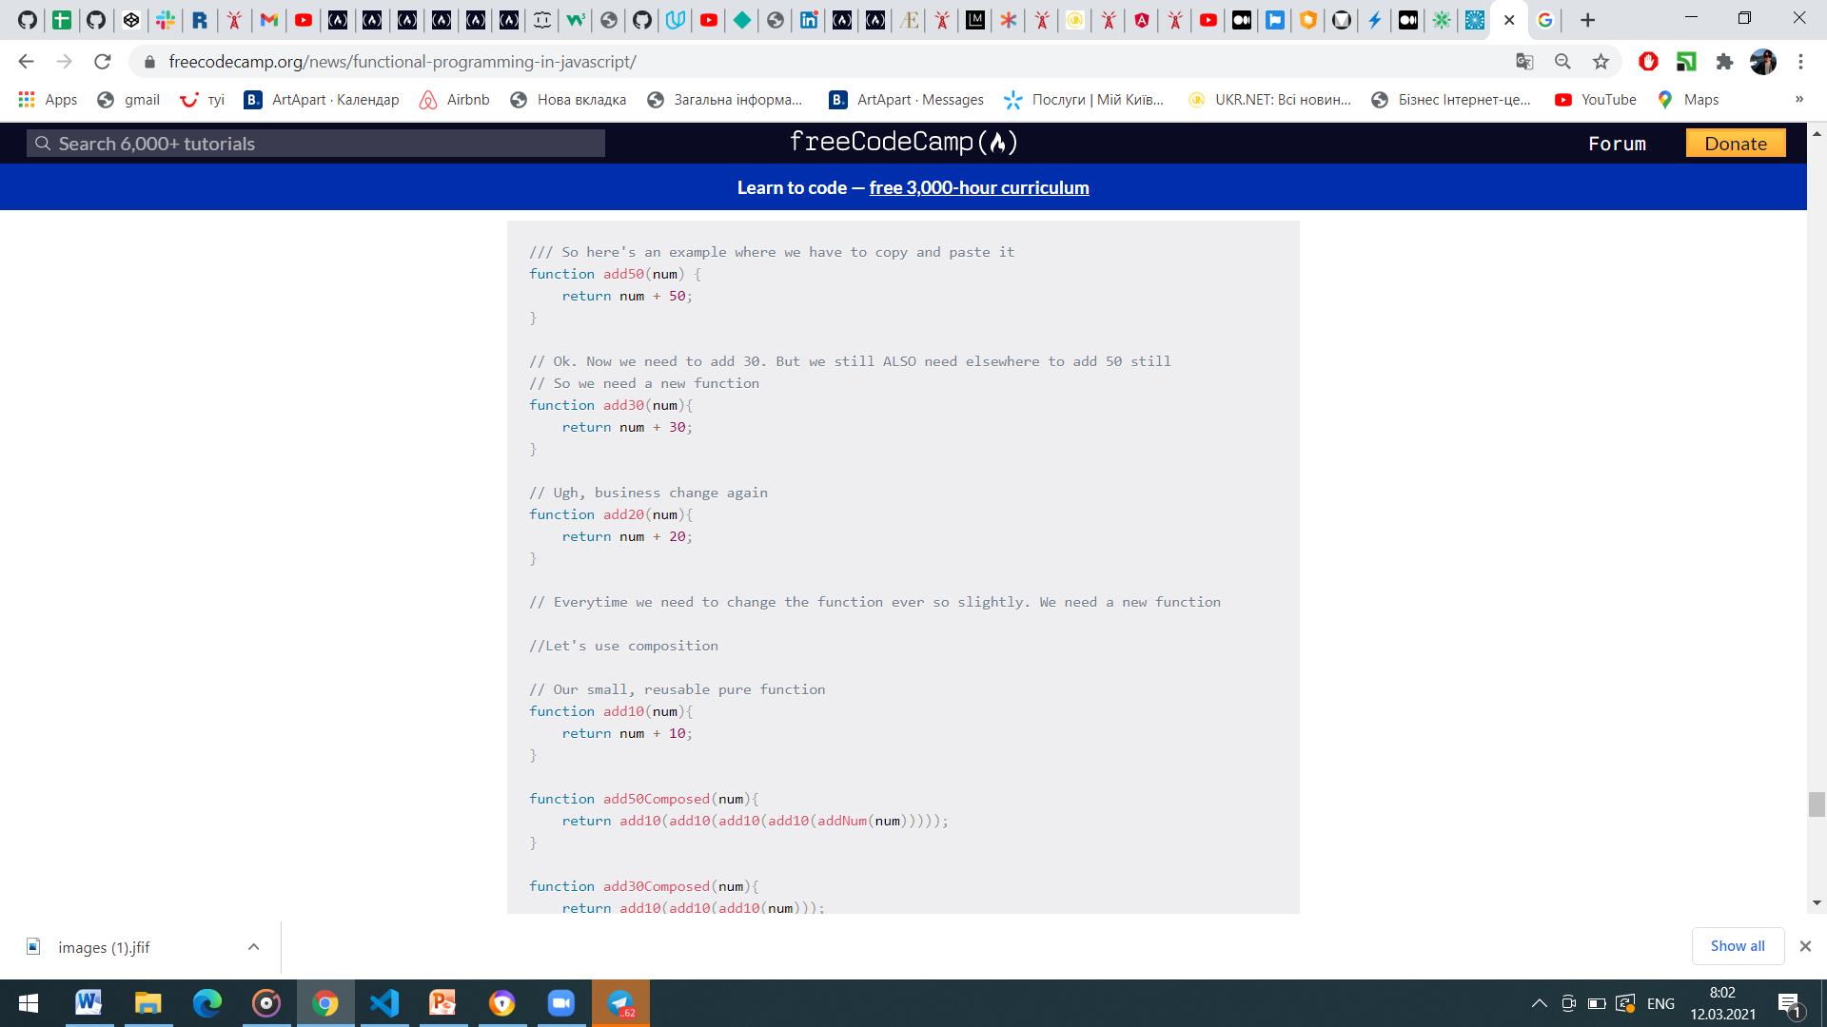
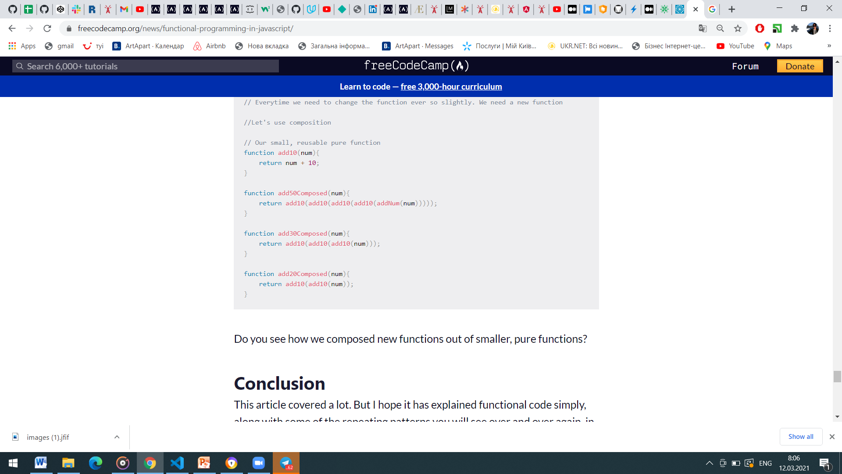
POWER OF FUNCTION COMPOSITION
Do you see how we composed new functions out of smaller, pure functions?

Slide 14
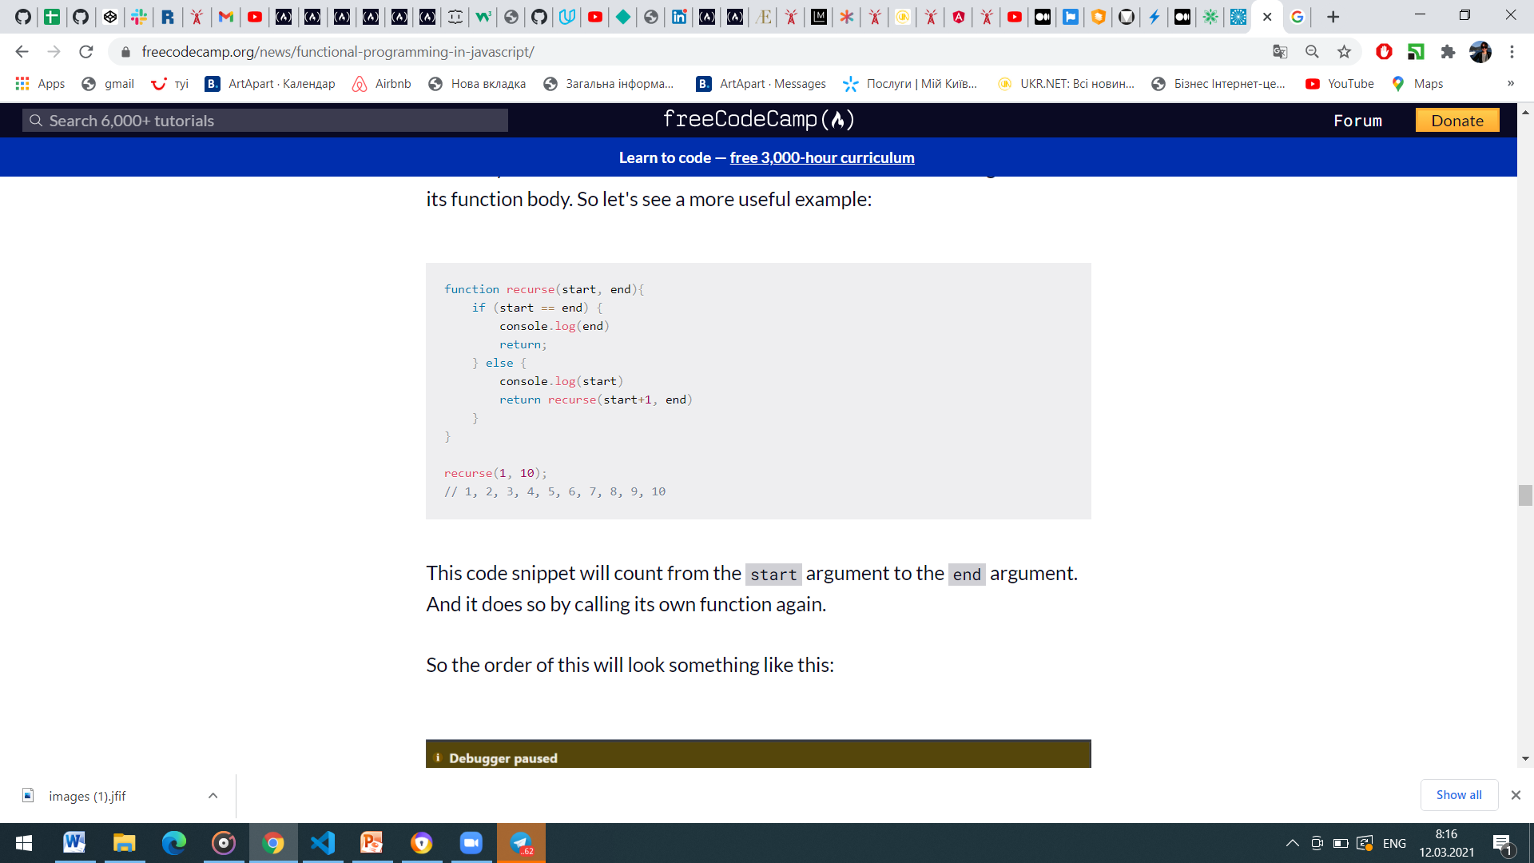
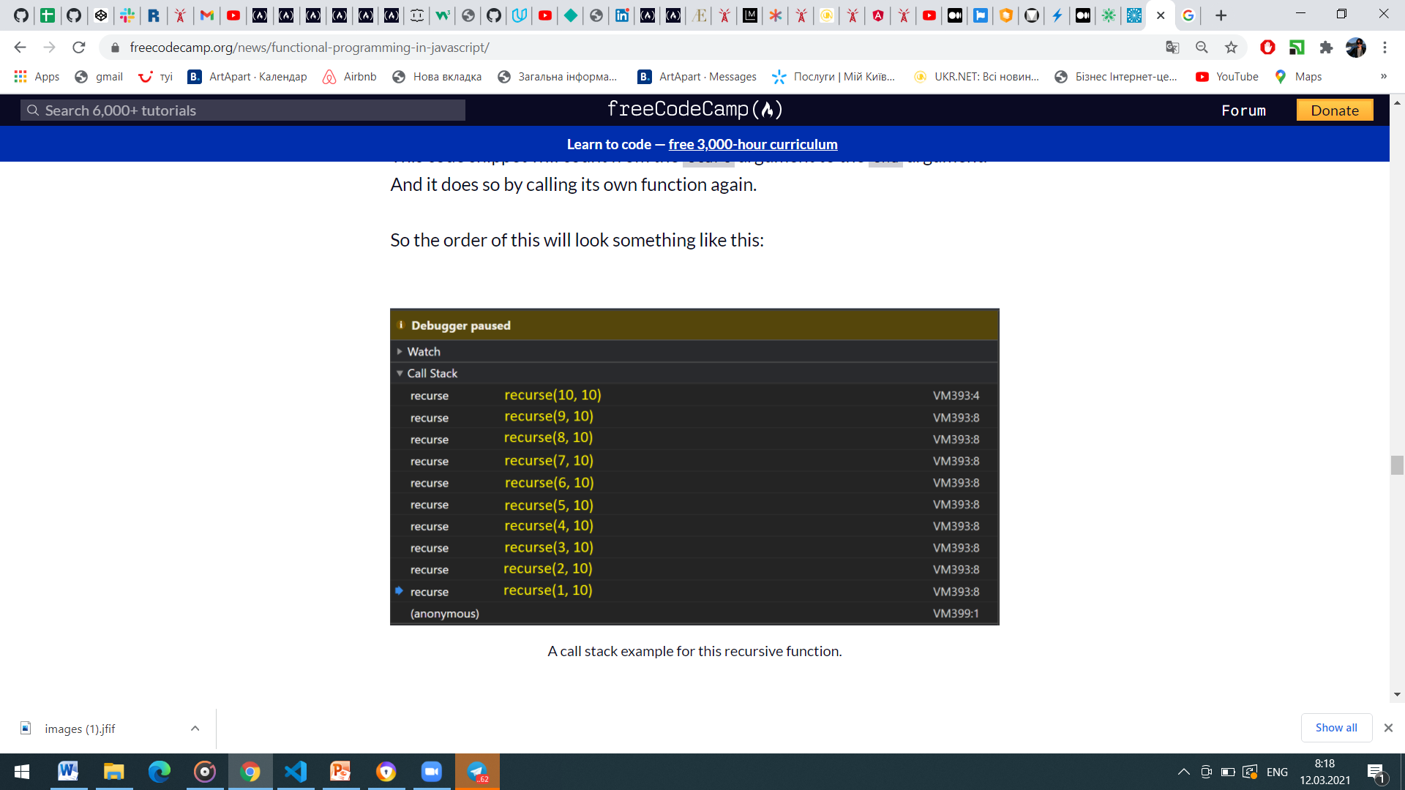
RECURSION IN FUNCTIONAL PROGRAMMING
It's possible in JavaScript to call a function from the function itself.
Recursion is one tool you can use to iterate in functional programming.
Why use recursion?
Recursion allows us to stop mutating state variables, for one.

Slide 15
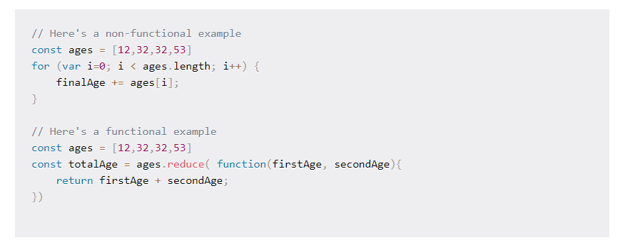
HIGHER ORDER FUNCTIONS
Functions that can be assigned to a variable, passed into another function, or returned from another function just like any other normal value, are called first class functions.
In JavaScript, all functions are first class functions. Functions that have a first class status allow us to create higher order functions.
A higher order function is a function that either take a function as an argument, returns a function, or both! You can use higher order functions to stop repeating yourself in your code.

Slide 16
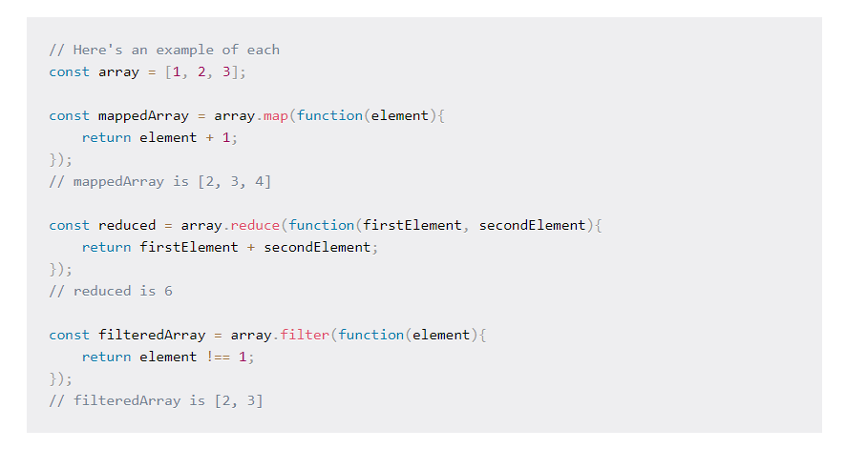
HIGHER ORDER FUNCTIONS EXAMPLES
Passing the results of functions into other functions, or even passing the functions themselves, in is extremely common in functional code.
These functions are also often used because they don't change the underlying function (no state change) but operate on a copy of the array.

Slide 17
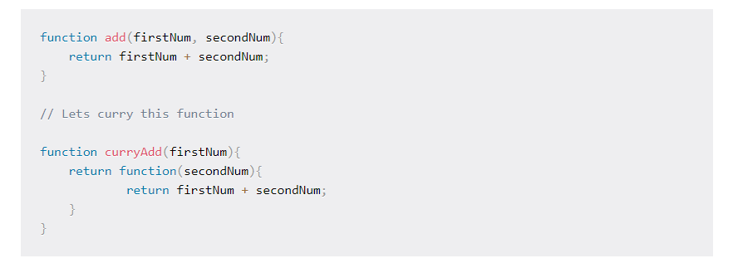
CURRYING IN FUNCTIONAL PROGRAMMING
Currying - is the process of taking a function that accepts n arguments and turning it into n functions that each accepts a single argument.
The arity of a function is the number of arguments that it accepts.
A function that accepts a single argument is unary, two arguments binary, three arguments ternary, and n arguments is n-ary.
it restructures a function so it takes one argument, but it then returns another function to take the next argument, as many times as it needs to.

Slide 18
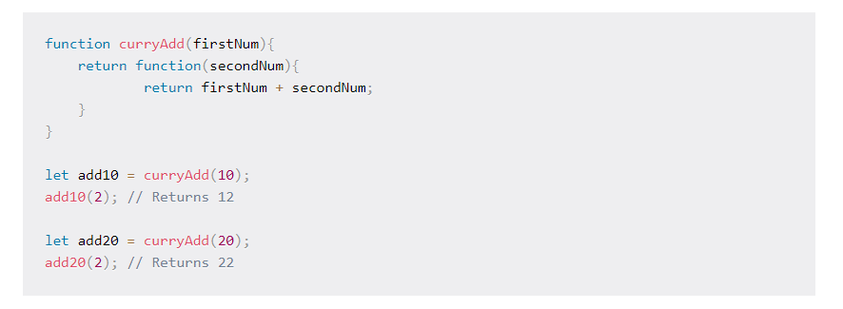
WHY USE CURRYING?
The big benefit of currying is when you need to re-use the same function multiple times but only change one (or fewer) of the parameters.
It's also helpful if you can't supply all the arguments to a function at one time. You can just return the first function to call the inner function when you have all the arguments later.
Currying can also make your code easier to refactor. You don't have to change multiple places where you are passing in the wrong function arguments – just the one place, where you bound the first function call to the wrong argument.

Slide 19
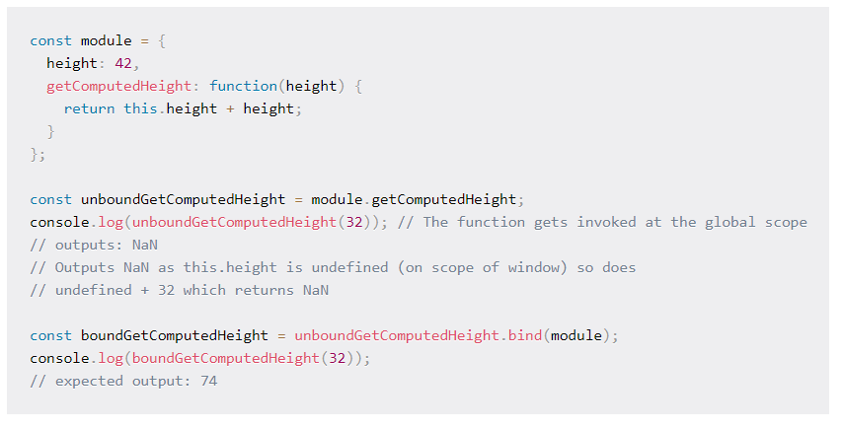
PARTIAL APPLICATION
Partial application means that you apply a few arguments to a function at a time and return another function that is applied to more arguments.
You can use partial application whenever you can't pass all your arguments at once, but can return functions from higher order functions to deal with the rest of the arguments.

Slide 20

FUNCTIONAL APPROACH IS TO:
Architect your software out of pure, isolated functions
Avoid mutability and side-effects
Make your code referentially transparent
Don't iterate

Slide 21


